Slide 1

Micro-Credit Defaulter Model
Using Machine Learning Algorithms
Created by-
Kunal Chand
Internship 19

Slide 2

INTRODUCTION
Build a model which can be used to predict in terms of a probability for each loan transaction, whether the customer will be paying back the loaned amount within 5 days of insurance of loan. In this case, Label ‘1’ indicates that the loan has been paid and Label ‘0’ means he is a defaulter.

Slide 3
The 7 Key Steps To Build Your Machine Learning Model
Step 1: Collect Data.
Step 2: Prepare the data.
Step 3: Choose the model.
Step 4 Train your machine model.
Step 5: Evaluation.
Step 6: Parameter Tuning.
Step 7: Prediction or Inference.

Slide 4
Data Exploration
Data exploration is the first step in data analysis and typically involves summarizing the main characteristics of a data set, including its size, accuracy, initial patterns in the data, and other attributes
It is commonly conducted by data analysts using visual analytics tools, but it can also be done in more advanced statistical software, Python.
An initial exploration of the data set can help answer these questions by familiarizing analysts with the data with which they are working.

Slide 5
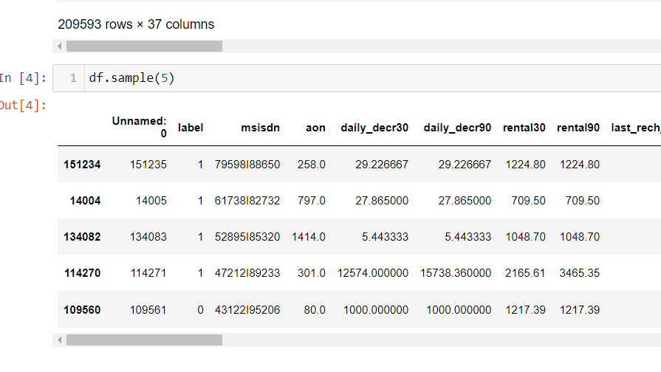
Data Sources and their formats
Most of the time data is in CSV file.
Then we load it in the system using python notebook and frame the data in data frame using pandas.
Dataset looks as follows-

Slide 6
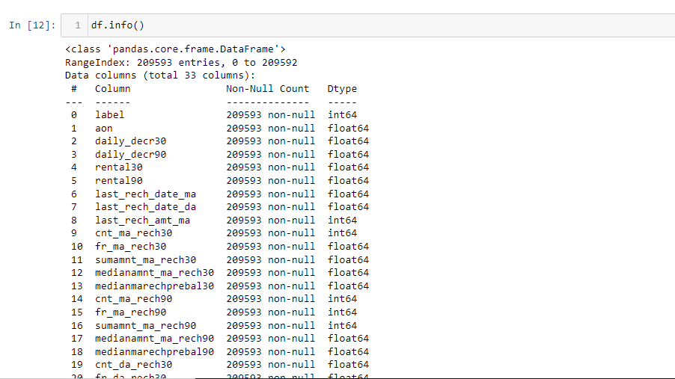
Dataset Information looks as follows-
Major data is float data type no null values in the data set.

Slide 7
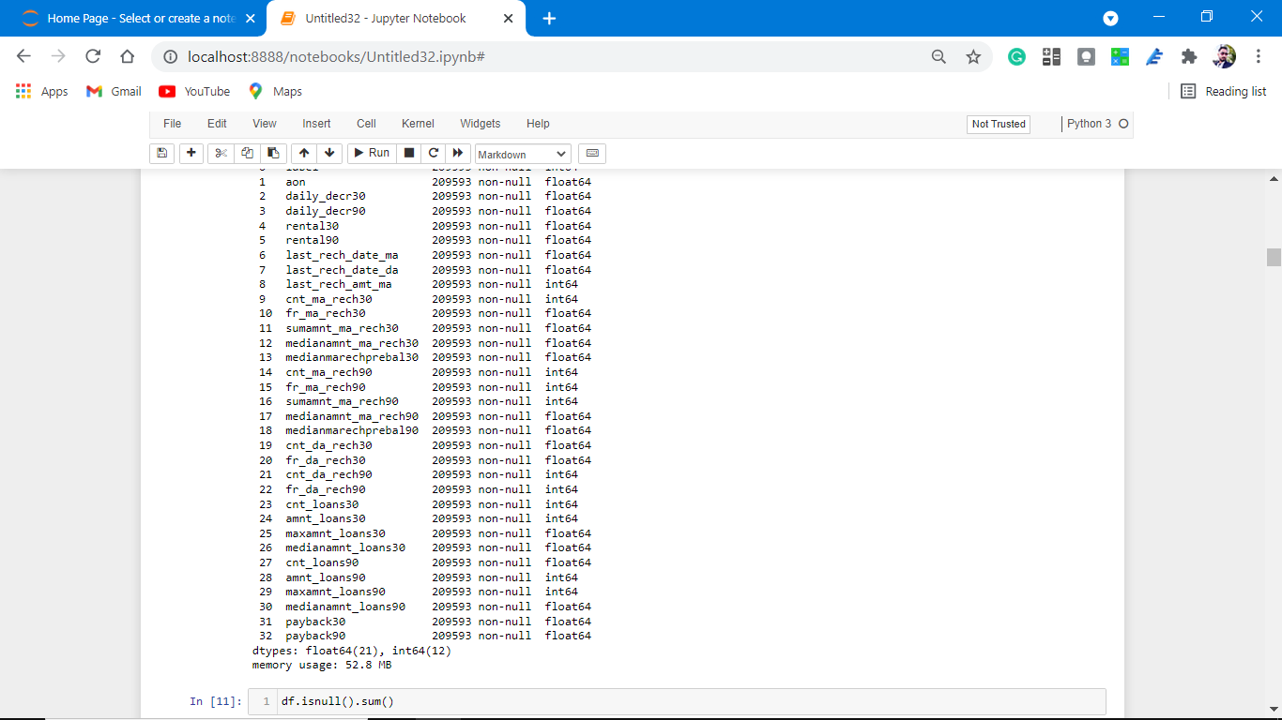

Slide 8
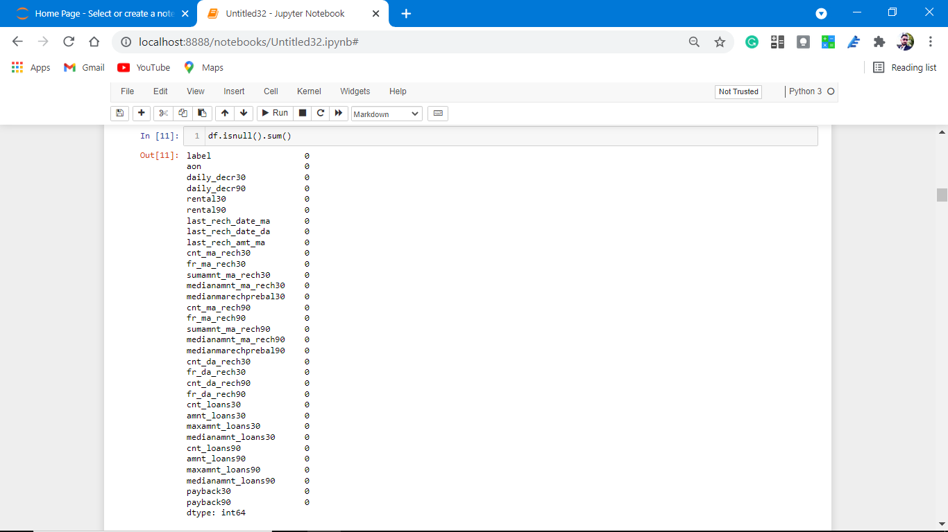
No null values are present in our dataset.

Slide 9
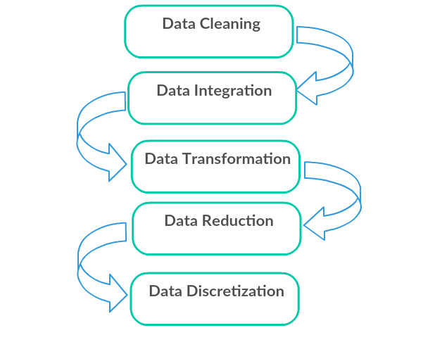
Data Pre-processing Done
Data pre-processing can refer to the manipulation or dropping of data before it is used to ensure or enhance performance, and is an important step in the data mining process.

Slide 10
Data Cleaning: First we clean the data which have no use in prediction like the ID column, then we drop the data which has a high no of missing percentages.
Data Integration: then we do some EDA process for finding out the meaning full insights of the data.
Data transformation is the process of changing the format, structure, or values of data; we use a labelled encoder for coding the object data into integer data.
Data Reduction: it is the process of finding the most correlated columns, and combining them because the machine does not understand which feature columns impact the most on accuracy.
Data discretization converts a large number of data values into smaller once, so that data evaluation and data management becomes very easy, using box plots is makes a clear understanding of the data.

Slide 11
EDA Concluding Remark.
As for any basic model building, we have to understand the type of target variable, the data of the target variable is continued or classified.
Data Analysis is always the difficult part, for better understanding different kinds of bar plots, distribution plots are created with the target Column for finding the insights of the dataset we have.
Analytical Modelling always starts with the target variable we have, and in that case, our target variable is Label, for that, we create some distribution plots with the target variable to understand which feature columns help to learn the model best and which feature columns reduce the accuracy of the model.
And after finding the relation and correlation with the target variable we choose either Regression Model or Classification Model. Here in this problem, our target feature column is categorical so we build our Machine Learning model on Classification.

Slide 12
Data Cleaning
First we clean the data which have no use in prediction like the ID column, then we drop the data which has a high no of missing percentages.
2. Like we drop unnamed :0, pdate,msidn,pcircle feature columns.
(df = df.drop(['Unnamed: 0','pdate','msisdn','pcircle'], axis=1)
#because there is no unique ness in feature column)
3. Then after PCA we drop some more columns as they having Multicollinearity.
df = df.drop(['daily_decr30','rental90','last_rech_date_da','medianmarechprebal90','fr_da_rech30','fr_da_rech90','medianamnt_loans30','payback90'], axis=1)

Slide 13
Visualization
Data visualization is the graphical representation of information and data. By using charts, plots, and graphs data visualization tools provide an accessible way to see and understand trends, outliers, and patterns in data.
In the world of Big Data, data visualization tools and technologies are essential to analyze massive amounts of information and make data-driven decisions.

Slide 14
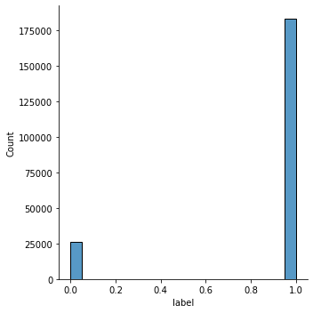
Visualization.
Visualization of the target varible.
Observations:
1.As seen from above distribution plot that classes are not equally distributed, Hence we have to use imbalance learn for data balancing.
2. The dataset is imbalanced. Label ‘1’ has approximately 87.5% records, while, label ‘0’ has approximately 12.5% records.

Slide 15
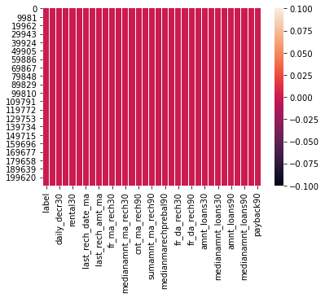
Visualization:
Heat Map Plotting for null values.
Observations:
1. As observed from the above there is no null values count
, we can easily visualize this heat map plotting.

Slide 16
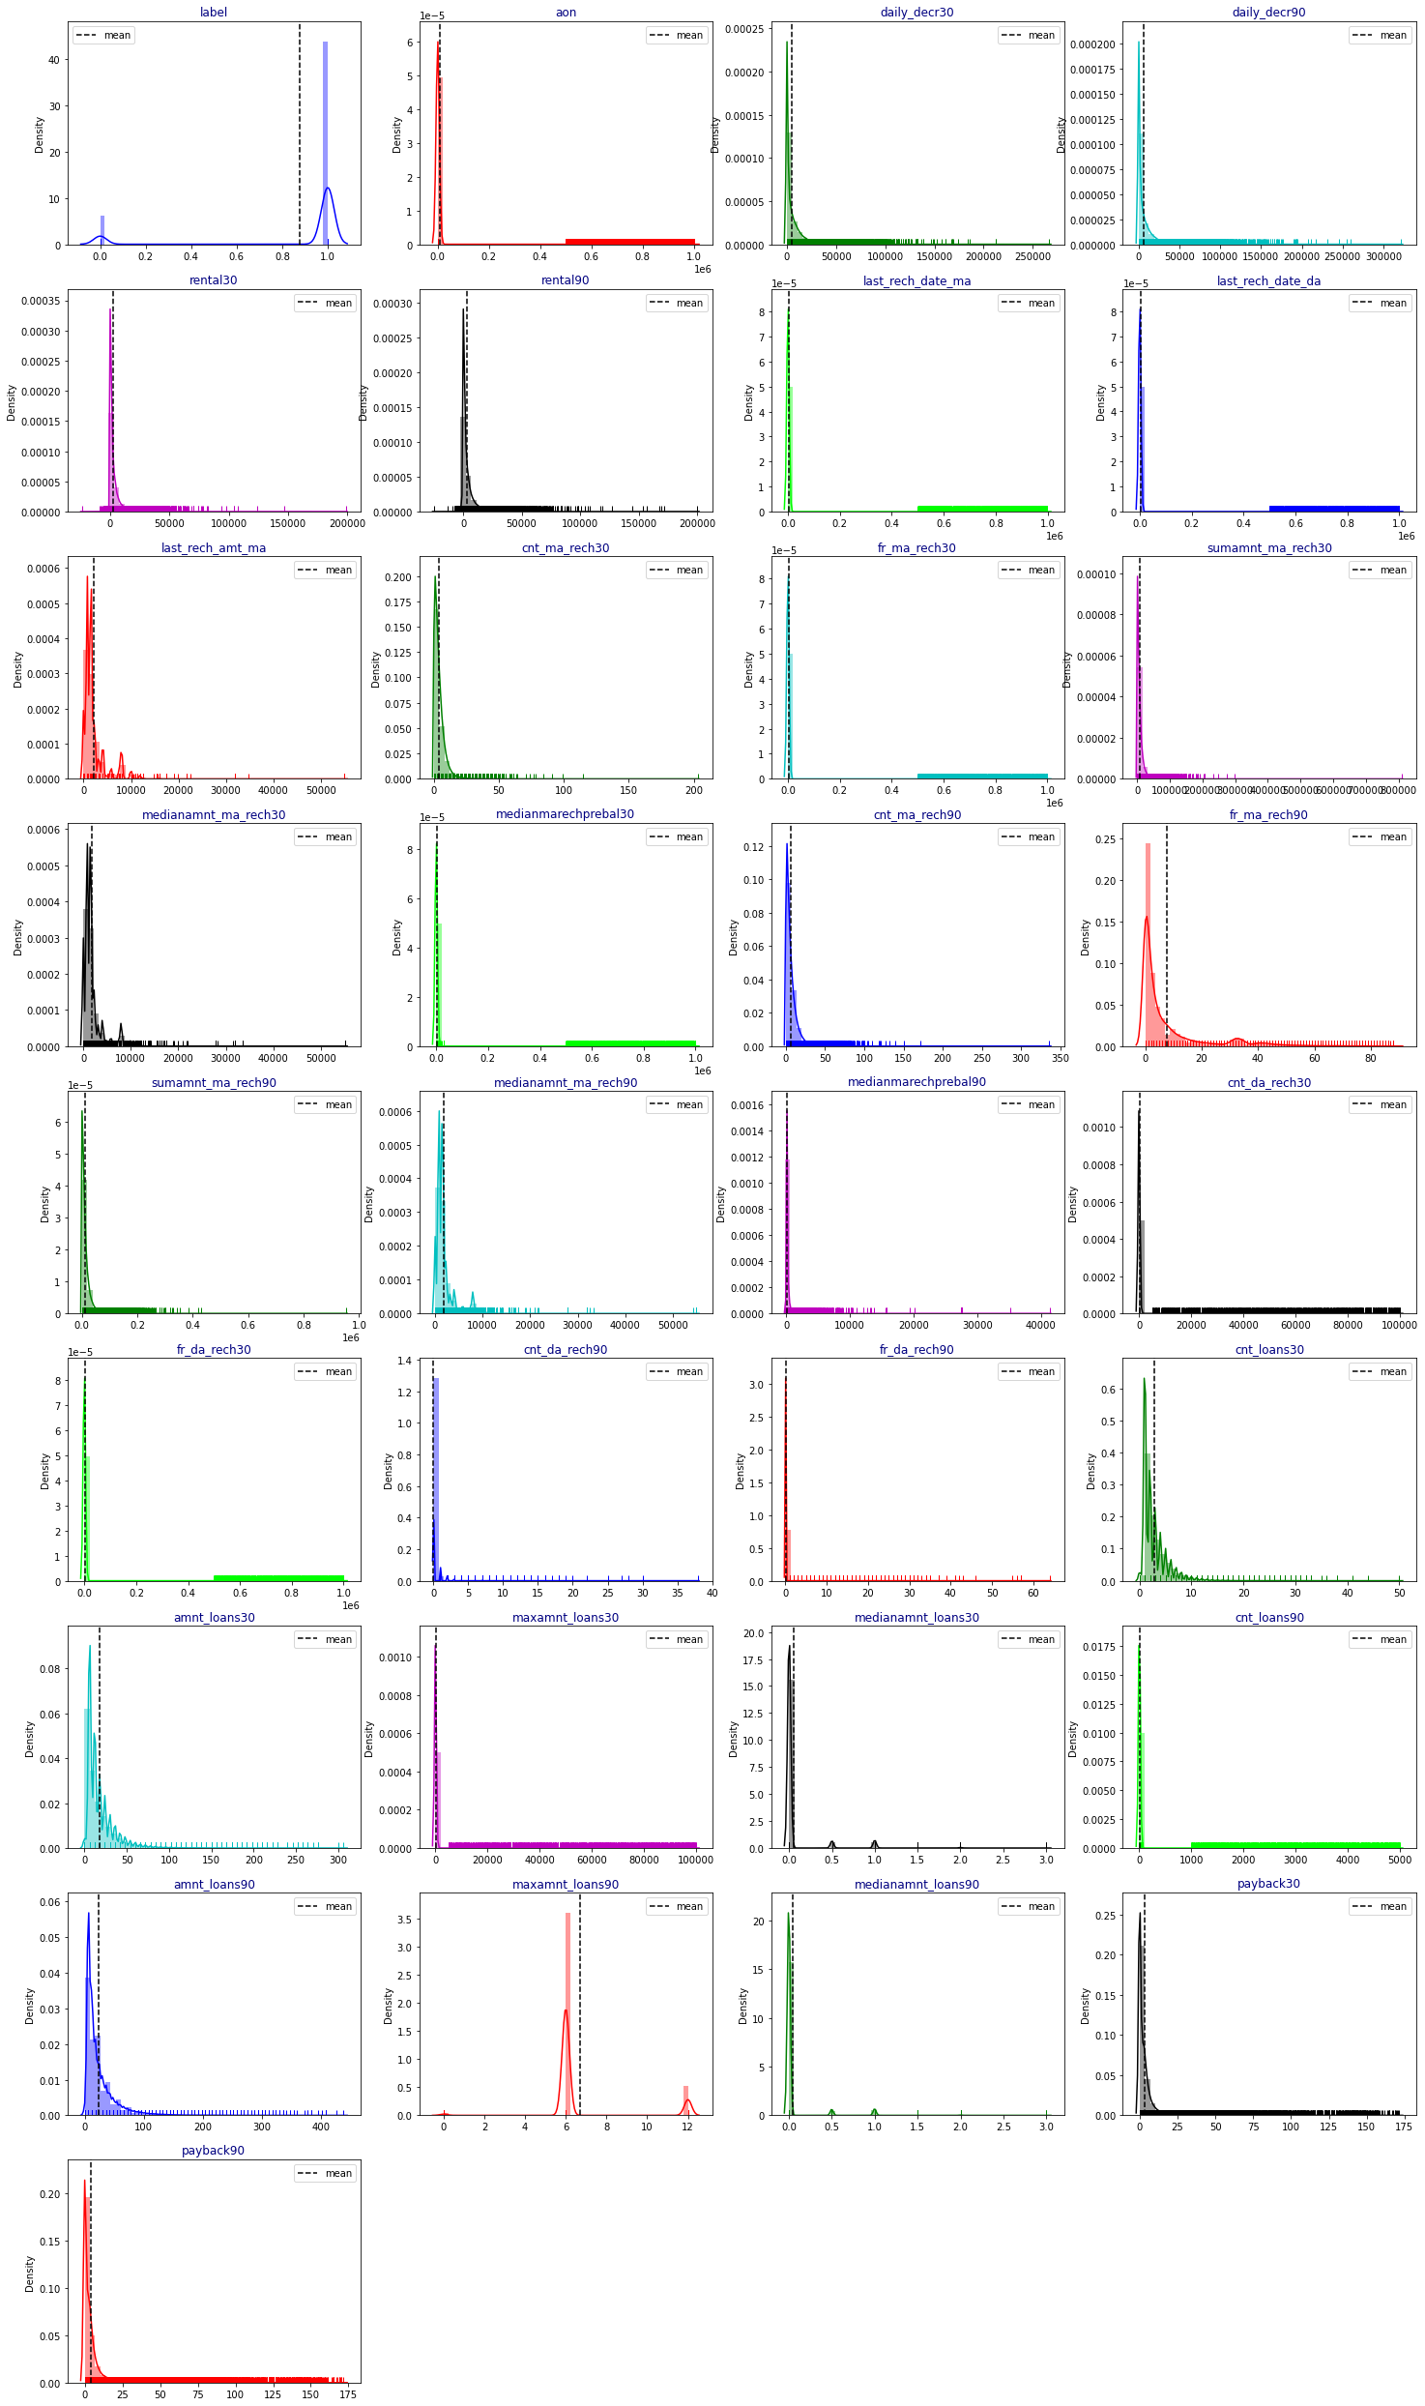
Visualization
Visualization of the Sales Price with Sales Condition.

Slide 17
Observations:
1. From the above plotting of distribution plot we see that some features columns are not normally distributed.
2. some columns are skewed towards the right.
3. Building blocks are out of the normal curve hence outliers are present.

Slide 18
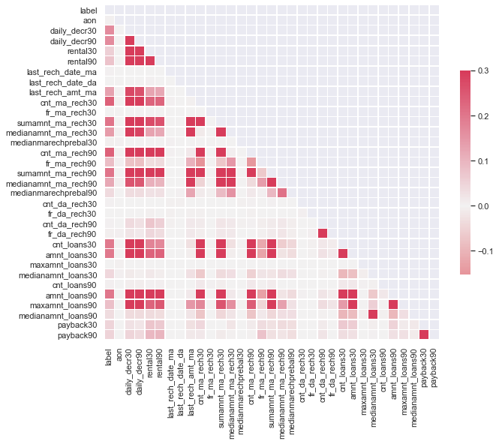
CORRELATION BETWEEN THE COLUMNS

Slide 19
Observations:
1. As from the above coding Multicollinearity is present in the dataset.
2. Colour blocks are having similar colours.

Slide 20
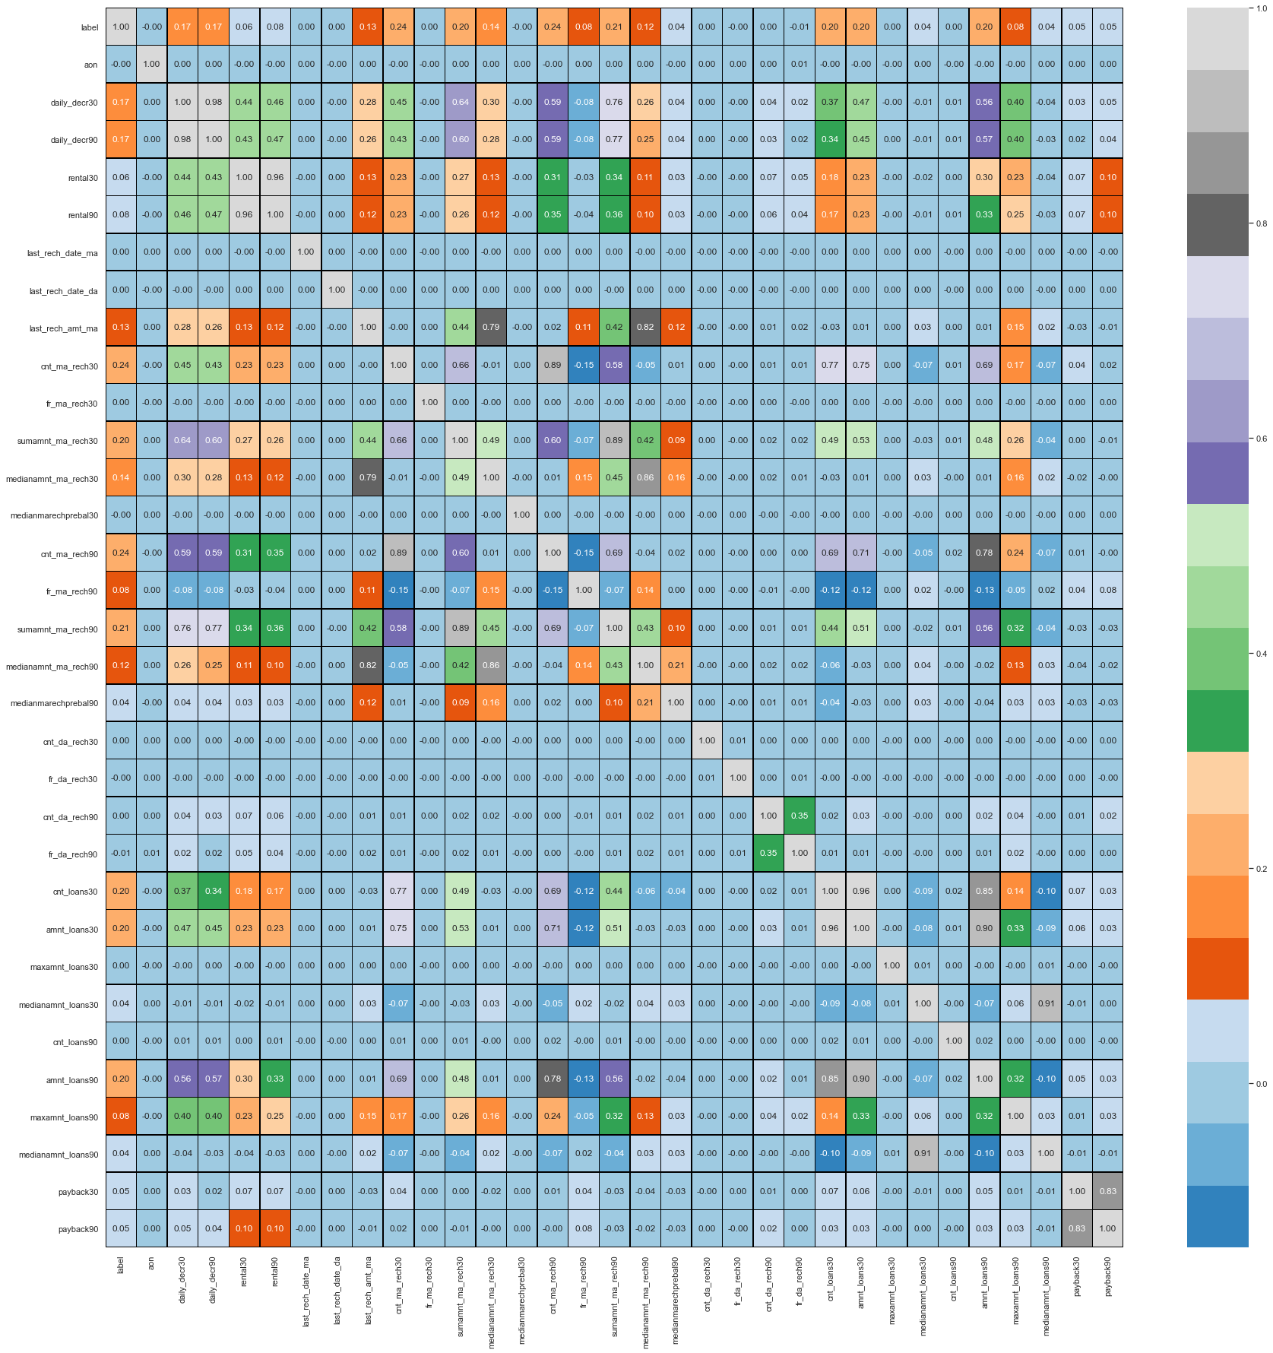
Heat Maps Plotting
Observations:
1. From the above result it is clear that some columns make a positive correlation and some make a negative correlation.
2. The positively correlated columns have a great impact on the target column while the negatively correlated have less or zero impact on the target column.
3. when we plot the heat map with notations is true. we can easily observe Multicollinearity between the columns.
4. Some feature columns with the same names but with
different periods have
Co-linearity.
5. Some feature columns are negative which impacts on accuracy and learning of the M.L model.

Slide 21
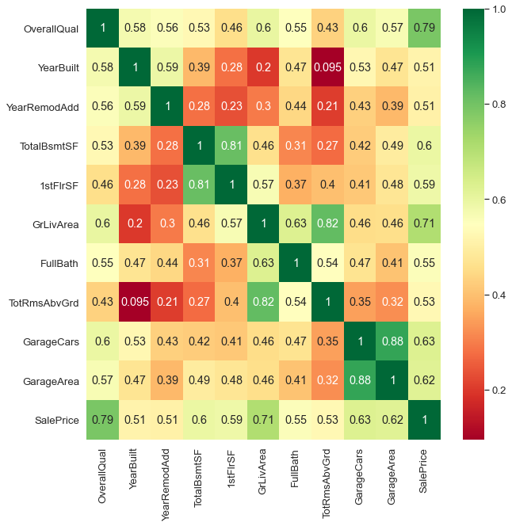
Top Correlated feature columns
Correlation:
1. These are positive feature columns with target variables.
2. These columns make the M.l model more accurate.

Slide 22
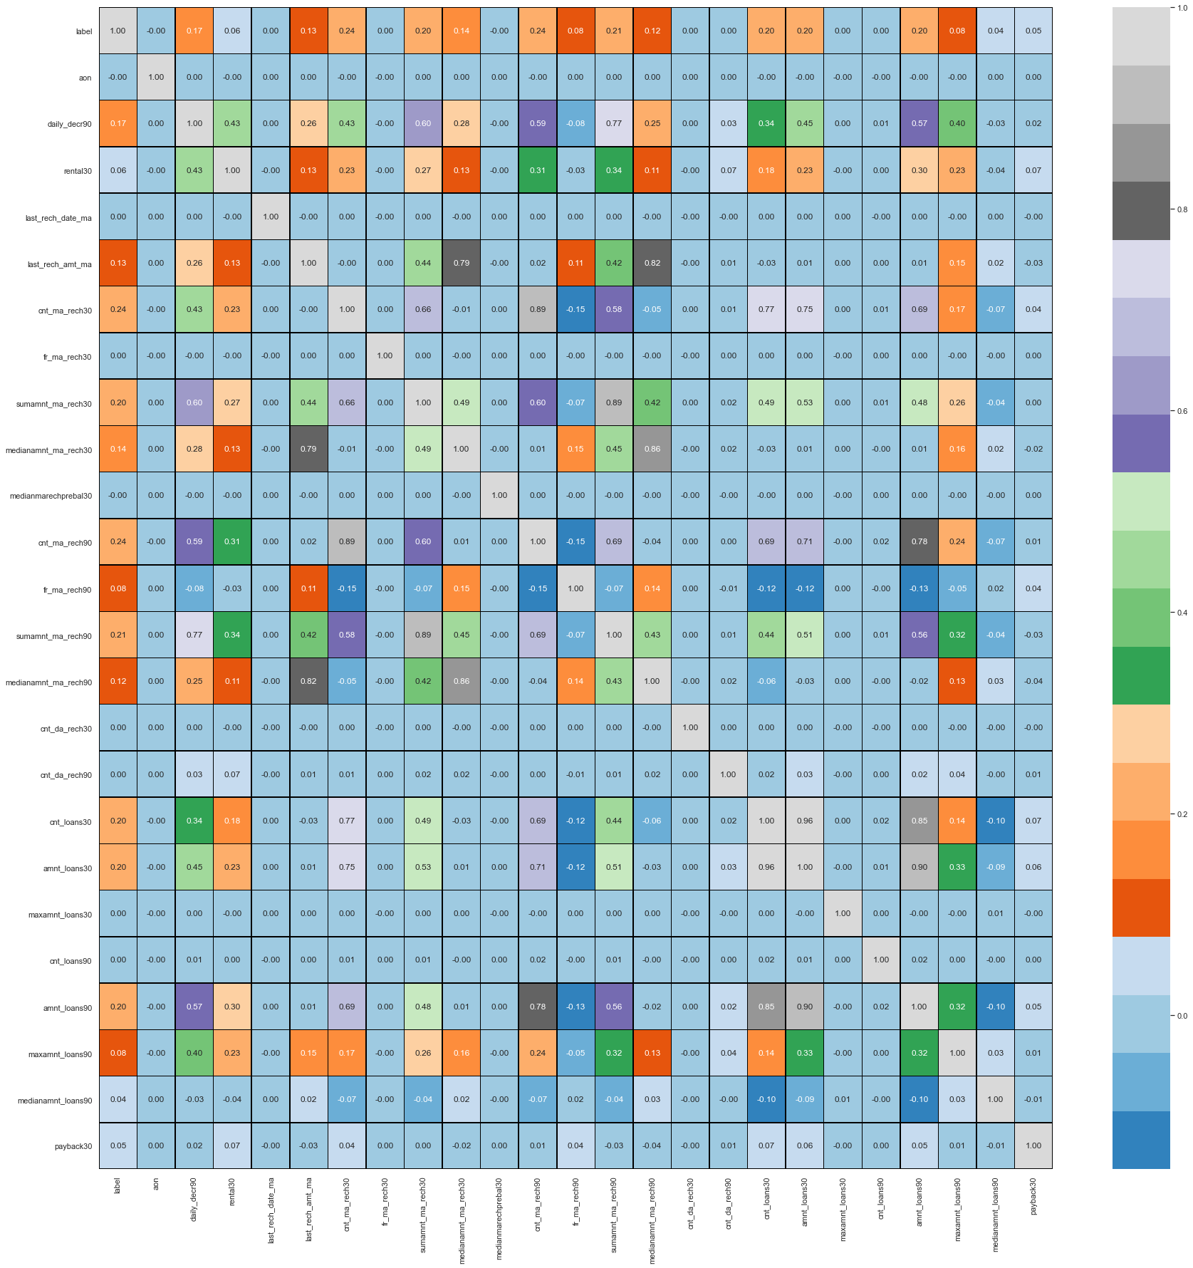
Visualization
Checking the Correlation Matrix after removing the collinear feature column.

Slide 23
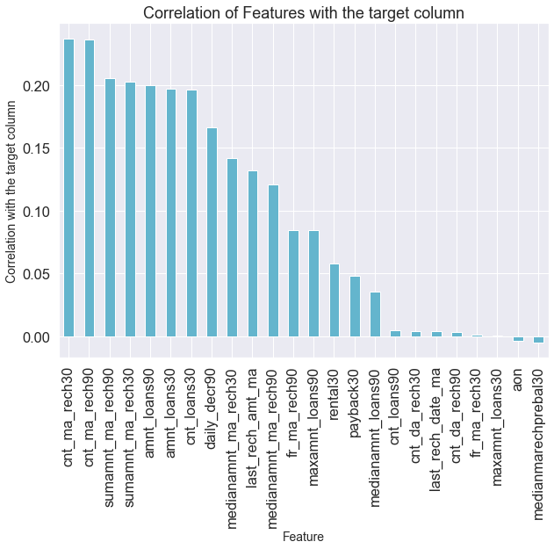
Correlation of features columns with target columns.

Slide 24
Observations:
1. There is a negative feature column with the
target variable.
2. aon and medianmarechprebal30 are negative feature columns with target columns.

Slide 25
Building Machine Learning Models
After analyzing the dataset, I observe that many of the feature columns are float type so we don’t need to label encode them, the machine interpret the float data and integer data easily. .
After printing information of dataset, we find there is no Nan values present in the dataset so we proceed forward.
Then find the correlation between the columns with target columns and delete the non-related feature columns.
We observe that the target column is skewed so we remove the skewness by using power transform method of the target column because normal data gives better results when we make the M.L model.
The target column is categorical type so we start work on Logistic Regression and after we do Classification model building.

Slide 26
Testing of Identified Approaches (Algorithms)
Logistic Regression
Regurgitation:
Ridge Classifier
Ensemble techniques
Decision Tree Classifier

Slide 27
Logistic Regression Model
Logistic Regression is a machine learning algorithm based on supervised learning.
• It performs a regression task. Regression models a target prediction value based on independent variables.
• It is mostly used for finding out the relationship between variables and forecasting

Slide 28
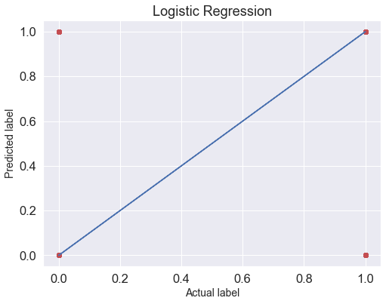

Slide 29
Observations:
This Logistic Regression Performs with 88% accuracy for predicting labels.
We use the best-fit line.
from sklearn.metrics import accuracy_score,confusion_matrix,classification_report
[[ 617 4256]
[ 315 32418]]
0.8784502473009627
precision recall f1-score support
0 0.66 0.13 0.21 4873
1 0.88 0.99 0.93 32733
accuracy 0.88 37606
macro avg 0.77 0.56 0.57 37606
weighted avg 0.86 0.88 0.84 37606
from above we easily find out that
Precision, recall,fl-score from the above plotting.
Our model performs well on the initial level,
Also, the cross-validation score at 3 is 87.88 which is almost the same as the accuracy of the model.

Slide 30
Regularization Ridge Classifier
To correctly fit in our model let's do some regulation.
The Ridge regressor has a classifier variant: Ridge Classifier. This classifier first converts binary targets to {-1, 1} and then treats the problem as a regression task, optimizing the same objective as above. The predicted class corresponds to the sign of the regress or's prediction. For multiclass classification, the problem is treated as multi-output regression, and the predicted class corresponds to the output with the highest value.

Slide 31
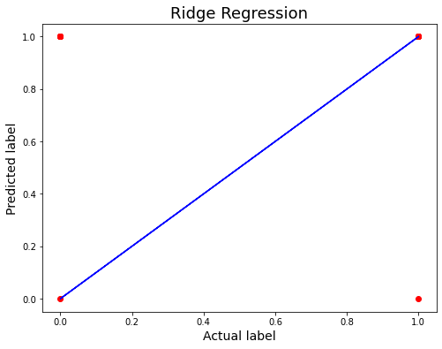

Slide 32
Observations:
1. This model is non-performing well.
2. There is a major difference between cross-validation and accuracy matrices.
Cross-Validation.
At cv:- 2
R2 Score: -14.462744289375662
Cross Val Score: 86.8590118598096
0.8708982609158114
print(accuracy_score(y_test,pred_decision))
print(confusion_matrix(y_test,pred_decision))
print(classification_report(y_test,pred_decision))
0.8708982609158114
[[ 2514 2359]
[ 2496 30237]]
precision recall f1-score support
0 0.50 0.52 0.51 4873
1 0.93 0.92 0.93 32733
accuracy 0.87 37606
macro avg 0.71 0.72 0.72 37606
weighted avg 0.87 0.87 0.87 37606
Accuracy is almost the same but cross-validation is not well for this model.

Slide 33
Ensemble Techniques:
Decision Tree Classifier
DecisionTreeClassifier is a class capable of performing multi-class classification on a dataset.
As with other classifiers, DecisionTreeClassifier takes as input two arrays: an array X, sparse or dense, of shape (n_samples, n_features) holding the training samples, and an array Y of integer values, shape (n_samples,), holding the class labels for the training samples:

Slide 34
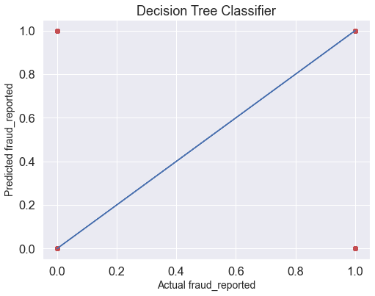

Slide 35
Observations:
This Decision Tree classifier Performs with 87% accuracy for predicting frauds.
After predicting and plotting the predicted data on the best fit line we observe that DT-C is not so accurate.
CV is not well. And does not give accurate results.
Cross-Validation.
At cv:- 2
R2 Score: -14.462744289375662
Cross Val Score: 86.8590118598096
0.8708982609158114
print(accuracy_score(y_test,pred_decision))
print(confusion_matrix(y_test,pred_decision))
print(classification_report(y_test,pred_decision))
0.8708982609158114
[[ 2514 2359]
[ 2496 30237]]
precision recall f1-score support
0 0.50 0.52 0.51 4873
1 0.93 0.92 0.93 32733
accuracy 0.87 37606
macro avg 0.71 0.72 0.72 37606
weighted avg 0.87 0.87 0.87 37606
Accuracy is almost the same but cross-validation is not well for this model.

Slide 36
Key Metrics
Confusion matrix, Mean Absolute Error, Mean Squared Error, Root Mean Square Error This matrix helps to understand the model more deeply.

Slide 37
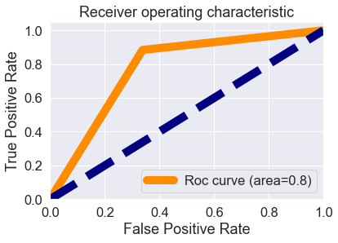
AUC-ROC curve

Slide 38
Observations:
1. Roc curve area is 0.8 which means that our model is distinguished between defaulter label and not defaulter label is 80%.
2. our model understands that label 1 is 80% different than label 0, which is good.
3. It means there is an 80% chance that the model will be able to distinguish between positive class and negative class.

Slide 39
Concluding Remarks.
So, our Aim is achieved as we have successfully ticked all our parameters as mentioned in our Aim Column. It is seen cnt_ma_rech30 is the most effective attribute in predicting the label column and that the logistic regression is the most effective model for our Dataset with cv and accuracy is 88%.

Slide 40
Interpretation of the Results
The best model is Logistic Regression as the CV score is best from the above-tested models.
At CV: - 7
Cross-validation score is :- 87.84502473009627 Accuracy Score:- 87.84502473009627
.

Slide 41
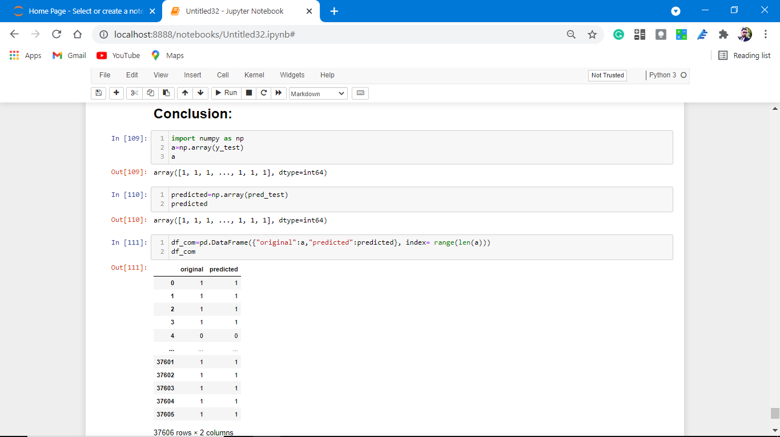

Slide 42
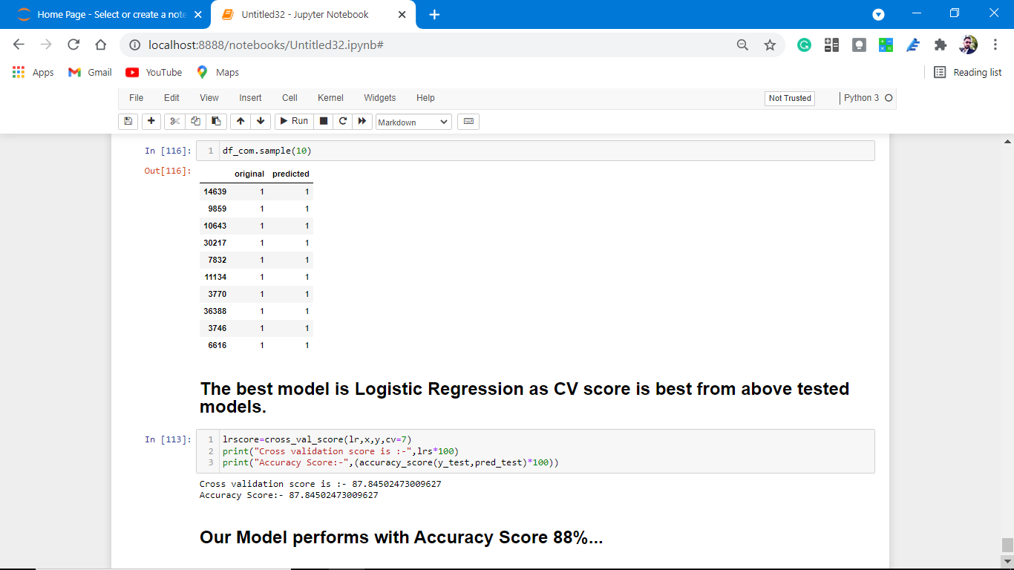

Slide 43
That's it! We reached the end of our presentation.
Throughout this kernel, we put in practice many of the strategies for predicting the prices of the house. We philosophized about the variables, we analyzed 'Sale Price' alone and with the most correlated variables, we dealt with missing data and outliers, we tested some of the fundamental statistical assumptions and we even transformed categorical variables into dummy variables. That's a lot of work that Python helped us make easier

Slide 44
Thank you

